Slide 1

Individual Homework Resolution Predicate
György Ferenc
2021.11.17.

Slide 2
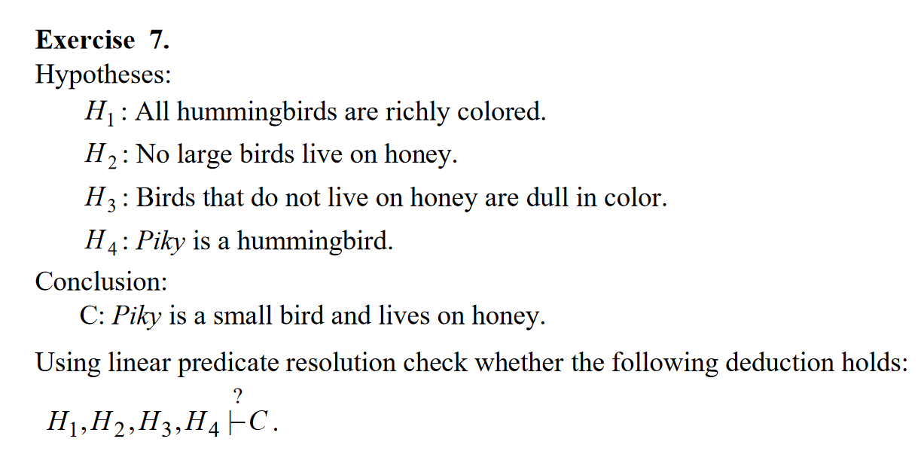
Problem Statement

Slide 3
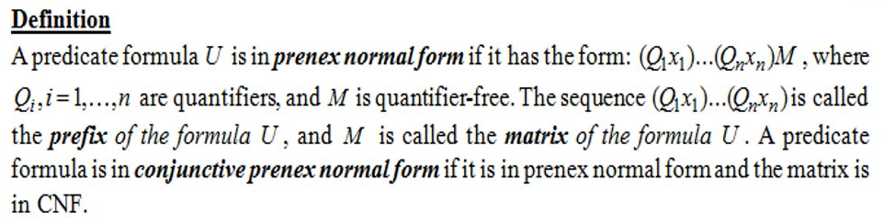
Theoretical Results
Inconsistency
A formula U is inconsistent if it has no models <=> all interpretations are anti-models <=> all interpretations evaluate the formula as false.
Prenex normal form

Slide 4
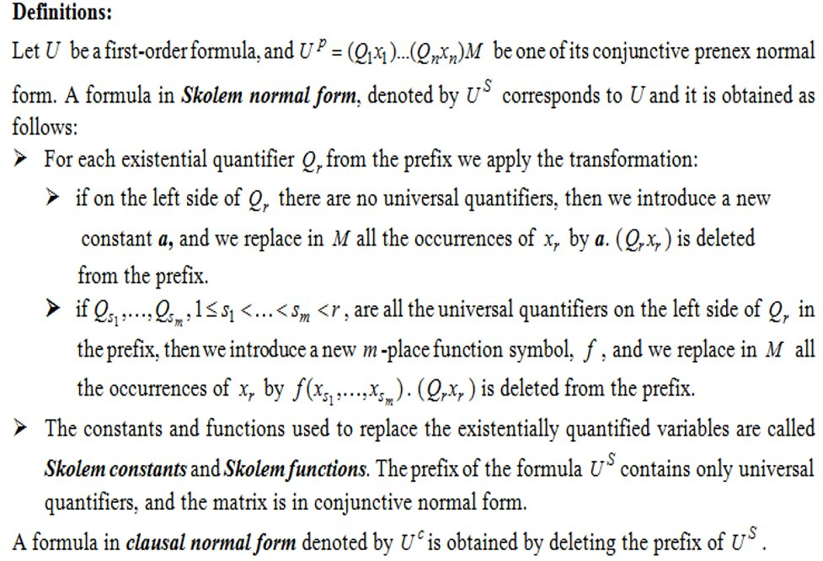
Skolem and clausal normal form

Slide 5
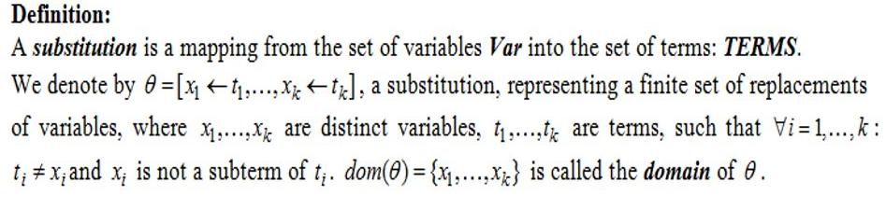
Substitution

Slide 6
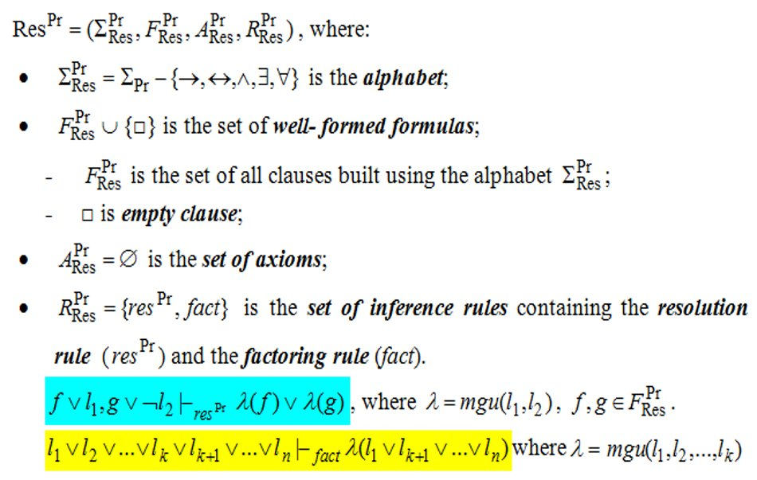
Predicate resolution

Slide 7
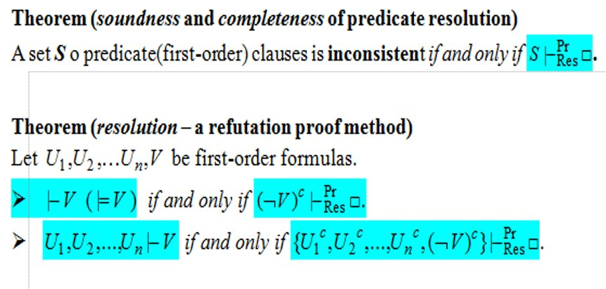
Predicate Resolution Theorem

Slide 8
D (domain) = all living bird
Signs: ∀→∨∧¬ ≡
Picky is a constant from D
Large, LivesOnHoney, RichlyColored, HummingBird are uniary predicates
Hypotheses:
H₁: All hummingbirds are richly colored.
H₂: No large birds live on honey.
H₃: Birds that do not live on honey are dull in color.
H₄: Piky is a hummingbird.
Conclusion:
C: Piky is a small bird and lives on honey.
H₁: (∀x)(HummingBird(x) → RichlyColored(x) )
H₂: (∀y)(Large(y) → ¬LivesOnHoney(y) )
H₃: (∀z)(¬LivesOnHoney(z) → ¬RichlyColored(z))
H₄: HummingBird(Piky)
C: ¬Large(Picky) ∧ LivesOnHoney(Piky)

Slide 9
H₁^{C}: ¬HummingBird(x) ∨ RichlyColored(x) = C₁
Signs: ∀→∨∧¬ ≡ □ ⟵ ⊢
H₂^{C}: ¬Large(y) ∨ ¬LivesOnHoney(y) = C₂
C₂
C₅
H₃^{C}: LivesOnHoney(z) ∨ ¬RichlyColored(z) = C₃
H₄^{C}: HummingBird(Piky) = C₄
(¬C)^{C}: Large(Picky) ∨ ¬LivesOnHoney(Piky)​ = C₅
C₆
C₃
To the set S = {C1, C2, C3, C4, C5}, linear general predicate resolution is applied:
C₂, C₅ ⊢^{[y ⟵ Piky]}_{Res Pr} C₆ = ¬LivesOnHoney(Piky)
C₆, C₃ ⊢^{[z ⟵ Piky]}_{Res Pr} C₇ = ¬RichlyColored(Piky)
C₇
C₁
C₇, C₁ ⊢^{[x ⟵ Piky]}_{Res Pr} C₈ = ¬HummingBird(Piky)
C₈, C₃ ⊢^{Pr}_{Res}C₉ = □
S ⊢ ^{Pr}_{Res} □ therefore S is inconsitent and the deduction H₁, H₂, H₃, H₄ ⊢ C holds
C₈
C₃
C₉

